Slide 1



Optimization of Solar Power Generation

Slide 2
Contents
Business Problem
Business Objective and Constraint
Project Architecture - Data Flow Diagram
Data Collection
Exploratory Data Analysis
Data Pre-processing
Data Visualization
Notes:
Change

Slide 3
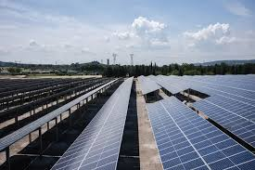
Business Problem
The client’s solar farm shows a power drop per string. With causes for the underperformance still unexplored

Slide 4


Business Objective And Constraints
Objective
Maximize energy efficiency
Constraints
Minimize operational cost

Slide 5
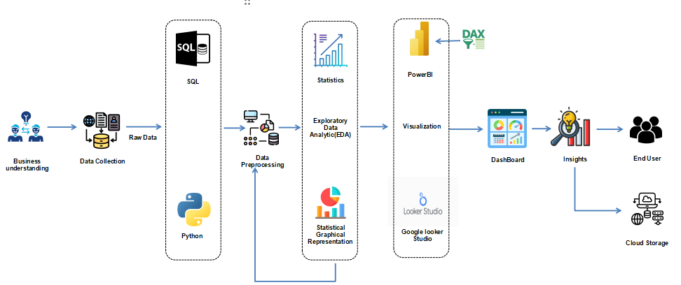
Project Architecture - Data Flow Diagram

Slide 6










Technical Stacks
Exploratory Data Analysis(EDA)
and
Data Pre- Processing
Visualization
Python
SQL
Power Bi
Google looker
Studio

Slide 7
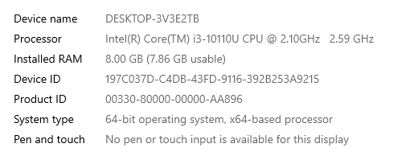
System Requirements
Install Anaconda, which includes Spyder, Python, and essential libraries like NumPy, Pandas, and Matplotlib for data analysis and visualization.
Install MySQL Community Edition, which includes the MySQL database server and MySQL Workbench for database management and development.
Download and install Power BI Desktop from the Microsoft website. Power BI Service can be accessed through a web browser.
Google Looker Studio is web-based, so it can be accessed from any operating system with a modern web browser.

Slide 8
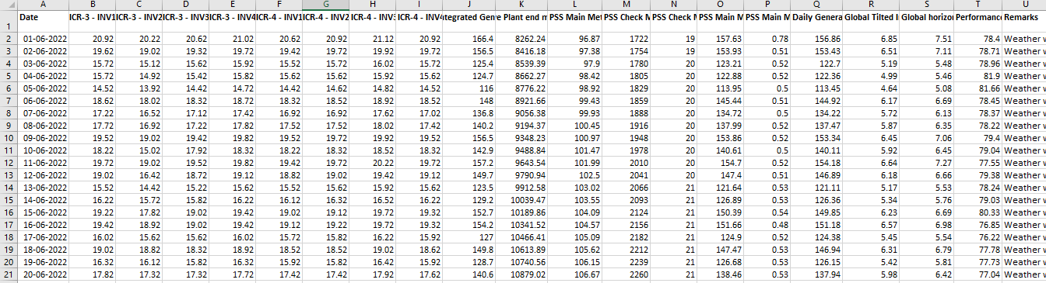
Data collection
Solar Dataset:
The type of data collection for the Solar Dataset is secondary data collection.
The shape of the Solar Dataset is (366, 23), indicating that it contains 366 rows and 23 columns.

Slide 9
Data Dictionary
Sn. No | Variable name | Variable Description | Data Type | Unit | Relevance | Data Measurement Scale
1 | Date | The date for which the data is recorded. | Date | - | Relevant | Nominal
2 | ICR-3 - INV1 | Performance or energy output data for Inverter 1 in ICR-3 section. | Numeric | MWh | Relevant | Ratio
3 | ICR-3 - INV2 | Performance or energy output data for Inverter 2 in ICR-3 section. | Numeric | MWh | Relevant | Ratio
4 | ICR-3 - INV3 | Performance or energy output data for Inverter 3 in ICR-3 section. | Numeric | MWh | Relevant | Ratio
5 | ICR-3 - INV4 | Performance or energy output data for Inverter 4 in ICR-3 section. | Numeric | MWh | Relevant | Ratio
6 | ICR-4 - INV1 | Performance or energy output data for Inverter 1 in ICR-4 section. | Numeric | MWh | Relevant | Ratio
7 | ICR-4 - INV2 | Performance or energy output data for Inverter 2 in ICR-4 section. | Numeric | MWh | Relevant | Ratio
8 | ICR-4 - INV3 | Performance or energy output data for Inverter 3 in ICR-4 section. | Numeric | MWh | Relevant | Ratio
9 | ICR-4V - INV4 | Performance or energy output data for Inverter 4 in ICR-4 section. | Numeric | MWh | Relevant | Ratio

Slide 10
Data Dictionary
Sn. No | Variable name | Variable Description | Data Type | Unit | Relevance | Data Measurement Scale
10 | TDIG, MWh | Total Daily Integrated Generation, which is the total energy generated by the plant over the course of a day, measured in megawatt-hours (MWh). | Numeric | MWh | Relevant | Ratio
11 | PSS Main Meter (Cumulative Plant end meter reading)(Export),MWH | Cumulative energy reading from the main meter at the plant end for energy exported to the grid, measured in megawatt-hours (MWh). | Numeric | MWh | Relevant | Ratio
12 | PSS Main Meter (Cumulative Plant end meter reading)(Import), MWh | Cumulative energy reading from the main meter at the plant end for energy imported from the grid, measured in megawatt-hours (MWh). | Numeric | MWh | Relevant | Ratio
13 | PSS Check Meter (Cumulative Plant end meter reading)(Export)MWh | Cumulative energy reading from the check meter at the plant end for energy exported to the grid, measured in megawatt-hours (MWh). | Numeric | MWh | Relevant | Ratio
14 | PSS Check Meter (Cumulative Plant end meter reading)(Import), MWh | Cumulative energy reading from the check meter at the plant end for energy imported from the grid, measured in megawatt-hours (MWh). | Numeric | MWh | Relevant | Ratio
15 | PSS Main Meter (Daily Generation Plant end meter )(Export), MWh | Daily energy generation reading from the main meter at the plant end for energy exported to the grid, measured in megawatt-hours (MWh). | Numeric | MWh | Relevant | Ratio
16 | PSS Main Meter (Daily Generation Plant end meter )(Import), MWh | Daily energy generation reading from the main meter at the plant end for energy imported from the grid, measured in megawatt-hours (MWh). | Numeric | MWh | Relevant | Ratio

Slide 11
Data Dictionary
Sn. No | Variable name | Variable Description | Data Type | Unit | Relevance | Data Measurement Scale
17 | Daily Generation Plant end meter (net), MWh | Net daily energy generation reading from the plant end meter, measured in megawatt-hours (MWh). | Numeric | MWh | Relevant | Ratio
18 | Global Tilted Irradiation/Irradiance (GTI)kWh/m2 | The amount of solar radiation received by the tilted solar panels, measured in kilowatt-hours per square meter (kWh/m²). | Numeric | kWh/m^2 | Relevant | Ratio
19 | Global horizontal irradiance (GHI)kWh/m2 | The amount of solar radiation received on a horizontal surface, measured in kilowatt-hours per square meter (kWh/m²). | Numeric | kWh/m^2 | Relevant | Ratio
20 | Performance Ratio (PR) % | A dimensionless ratio that measures the plant's performance relative to its theoretical maximum output. | Numeric | - | Relevant | Ratio
21 | Grid Downtime HH:MM | The duration (in hours and minutes) when the plant was disconnected from the grid. | Time | Hours: Minutes | Relevant | Interval
22 | Plant Downtime HH:MM | The duration (in hours and minutes) when the plant was not operational. | Time | Hours: Minutes | Relevant | Interval
23 | Remarks | A column for any additional remarks or comments related to the data. | Text | - | Relevant | Nominal

Slide 12
Exploratory Data Analysis [EDA]
The Solar dataset comprises 366 records and includes 23 essential columns: 'Date', 'ICR-3 - INV1', 'ICR-3 - INV2', 'ICR-3 - INV3', 'ICR-3 - INV4’, 'ICR-4 - INV1', 'ICR-4 - INV2', 'ICR-4 - INV3', 'ICR-4 - INV4',
'Total Daily Integrated Generation MWh',
'PSS Main Meter (Cumulative Plant end meter reading)(Export)MWH',
'PSS Main Meter (Cumulative Plant end meter reading)(Import)MWh',
'PSS Check Meter (Cumulative Plant end meter reading)(Export)MWh',
'PSS Check Meter (Cumulative Plant end meter reading)(Import)MWh',
'PSS Main Meter (Daily Generation Plant end meter )(Export)MWh',
'PSS Main Meter (Daily Generation Plant end meter )(Import)MWh',
'Daily Generation Plant end meter (net)MWh',
'Global Tilted Irradiation/Irradiance (GTI)kWh/m2',
'Global horizontal irradiance (GHI)kMh/m2', 'Performance Ratio (PR) %',
'Grid Downtime HH:MM', 'Plant Downtime HH:MM', 'Remarks'
Notes:
EDA is used for seeing what the data can tell us before the modeling task.
Change

Slide 13
Exploratory Data Analysis [EDA]
Descriptive statistics for numeric columns (', 'ICR-3 - INV1', 'ICR-3 - INV2', 'ICR-3 - INV3', 'ICR-3 - INV4’, 'ICR-4 - INV1', 'ICR-4 - INV2', 'ICR-4 - INV3', 'ICR-4 - INV4',
'Total Daily Integrated Generation MWh',
'PSS Main Meter (Cumulative Plant end meter reading)(Export)MWH',
'PSS Main Meter (Cumulative Plant end meter reading)(Import)MWh',
'PSS Check Meter (Cumulative Plant end meter reading)(Export)MWh',
'PSS Check Meter (Cumulative Plant end meter reading)(Import)MWh',
'PSS Main Meter (Daily Generation Plant end meter )(Export)MWh',
'PSS Main Meter (Daily Generation Plant end meter )(Import)MWh',
'Daily Generation Plant end meter (net)MWh',
'Global Tilted Irradiation/Irradiance (GTI)kWh/m2',
'Global horizontal irradiance (GHI)kMh/m2', 'Performance Ratio (PR) %) like mean, median, variance, standard deviation, range, skewness, and kurtosis provide insights into distribution and variability, aiding in inventory planning and risk assessment.
Mode for Category column 'Remarks'

Slide 14
Exploratory Data Analysis [EDA]
 | First moment Business Decision | Before Data Pre-processing | After Data Pre-processing
Mean | ICR-3 - INV1 | 15.32 | 15.31799
 | ICR-3 - INV2 | 15.13 | 15.13379
 | ICR-3 - INV3 | 15.36 | 15.36045
 | ICR-3 - INV4 | 15.42 | 15.4177
 | ICR-4 - INV1 | 15.11 | 15.10945
 | ICR-4 - INV2 | 15.2 | 15.19701
 | ICR-4 - INV3 | 15.45 | 15.44945
 | ICR-4 - INV4 | 15.2 | 15.19615
 | Total Daily Integrated Generation MWh | 122.16 | 122.1645
Median | PSS Main Meter (Cumulative Plant end meter reading)(Export)MWH | 30685.52 | 30685.52
 | PSS Main Meter (Cumulative Plant end meter reading)(Import)MWh | 213.03 | 213.0339
 | PSS Check Meter (Cumulative Plant end meter reading)(Export)MWh | 6394.81 | 6394.81
 | PSS Check Meter (Cumulative Plant end meter reading)(Import)MWh | 42.42 | 42.42241
 | PSS Main Meter (Daily Generation Plant end meter )(Export)MWh | 157.63 | 157.6346
 | PSS Main Meter (Daily Generation Plant end meter )(Import)MWh | 0.78 | 0.777291
 | Daily Generation Plant end meter (net)MWh | 156.86 | 156.8601
 | Global Tilted Irradiation/Irradiance (GTI)kWh/m2 | 5.08 | 5.07569
 | Global horizontal irradiance(GHI)kWh/m2 | 4.79 | 4.794511
 | Performance Ratio (PR) % | 79 | 78.9971

Slide 15
Exploratory Data Analysis [EDA]
 | First moment Business Decision | Before Data Pre-processing | After Data Pre-processing
Median | ICR-3 - INV1 | 16.12 | 16.12
 | ICR-3 - INV2 | 15.82 | 15.82
 | ICR-3 - INV3 | 16.02 | 16.02
 | ICR-3 - INV4 | 16.12 | 16.12
 | ICR-4 - INV1 | 15.77 | 15.77
 | ICR-4 - INV2 | 15.82 | 15.82
 | ICR-4 - INV3 | 16.12 | 16.12
 | ICR-4 - INV4 | 15.92 | 15.92
 | Total Daily Integrated Generation MWh | 127.15 | 127.15
Median | PSS Main Meter (Cumulative Plant end meter reading)(Export)MWH | 28280.7 | 28280.7
 | PSS Main Meter (Cumulative Plant end meter reading)(Import)MWh | 196.02 | 196.02
 | PSS Check Meter (Cumulative Plant end meter reading)(Export)MWh | 5893.5 | 5893.5
 | PSS Check Meter (Cumulative Plant end meter reading)(Import)MWh | 39 | 39
 | PSS Main Meter (Daily Generation Plant end meter )(Export)MWh | 146.71 | 146.71
 | PSS Main Meter (Daily Generation Plant end meter )(Import)MWh | 0.62 | 0.615
 | Daily Generation Plant end meter (net)MWh | 146.07 | 146.065
 | Global Tilted Irradiation/Irradiance (GTI)kWh/m2 | 5.35 | 5.35
 | Global horizontal irradiance(GHI)kWh/m2 | 4.86 | 4.855
 | Performance Ratio (PR) % | 78.4 | 78.4
Mode | Remarks | Weather was Partially Cloudy | Weather was Partially Cloudy

Slide 16
Exploratory Data Analysis [EDA]
 | First moment Business Decision | Before Data Pre-processing | After Data Pre-processing
Variance | ICR-3 - INV1 | 15.69 | 15.69358
 | ICR-3 - INV2 | 14.41 | 14.41289
 | ICR-3 - INV3 | 15.05 | 15.0451
 | ICR-3 - INV4 | 15.49 | 15.49025
 | ICR-4 - INV1 | 13.97 | 13.97497
 | ICR-4 - INV2 | 16.35 | 16.34634
 | ICR-4 - INV3 | 15.61 | 15.61471
 | ICR-4 - INV4 | 15.27 | 15.2681
 | Total Daily Integrated Generation MWh | 974.44 | 974.4412
Median | PSS Main Meter (Cumulative Plant end meter reading)(Export)MWH | 2.35E+08 | 2.35E+08
 | PSS Main Meter (Cumulative Plant end meter reading)(Import)MWh | 6251.42 | 6251.415
 | PSS Check Meter (Cumulative Plant end meter reading)(Export)MWh | 10185603 | 10185603
 | PSS Check Meter (Cumulative Plant end meter reading)(Import)MWh | 251.99 | 251.9911
 | PSS Main Meter (Daily Generation Plant end meter )(Export)MWh | 4424.22 | 4424.224
 | PSS Main Meter (Daily Generation Plant end meter )(Import)MWh | 0.14 | 0.140793
 | Daily Generation Plant end meter (net)MWh | 4410.37 | 4410.367
 | Global Tilted Irradiation/Irradiance (GTI)kWh/m2 | 2.02 | 2.015425
 | Global horizontal irradiance(GHI)kWh/m2 | 2.12 | 2.122712
 | Performance Ratio (PR) % | 14.18 | 14.17637

Slide 17
Exploratory Data Analysis [EDA]
 | First moment Business Decision | Before Data Pre-processing | After Data Pre-processing
Standard Deviation | ICR-3 - INV1 | 3.96 | 3.961512
 | ICR-3 - INV2 | 3.8 | 3.796432
 | ICR-3 - INV3 | 3.88 | 3.878802
 | ICR-3 - INV4 | 3.94 | 3.935766
 | ICR-4 - INV1 | 3.74 | 3.738311
 | ICR-4 - INV2 | 4.04 | 4.043061
 | ICR-4 - INV3 | 3.95 | 3.951546
 | ICR-4 - INV4 | 3.91 | 3.907442
 | Total Daily Integrated Generation MWh | 31.22 | 31.21604
Median | PSS Main Meter (Cumulative Plant end meter reading)(Export)MWH | 15317.71 | 15317.71
 | PSS Main Meter (Cumulative Plant end meter reading)(Import)MWh | 79.07 | 79.06589
 | PSS Check Meter (Cumulative Plant end meter reading)(Export)MWh | 3191.49 | 3191.489
 | PSS Check Meter (Cumulative Plant end meter reading)(Import)MWh | 15.87 | 15.87423
 | PSS Main Meter (Daily Generation Plant end meter )(Export)MWh | 66.51 | 66.51484
 | PSS Main Meter (Daily Generation Plant end meter )(Import)MWh | 0.38 | 0.375223
 | Daily Generation Plant end meter (net)MWh | 66.41 | 66.4106
 | Global Tilted Irradiation/Irradiance (GTI)kWh/m2 | 1.42 | 1.419657
 | Global horizontal irradiance(GHI)kWh/m2 | 1.46 | 1.456953
 | Performance Ratio (PR) % | 3.77 | 3.765152

Slide 18
Exploratory Data Analysis [EDA]
 | First moment Business Decision | Before Data Pre-processing | After Data Pre-processing
Range | ICR-3 - INV1 | 15.46 | 15.4625
 | ICR-3 - INV2 | 14.9 | 14.9
 | ICR-3 - INV3 | 15.06 | 15.0625
 | ICR-3 - INV4 | 15.5 | 15.5
 | ICR-4 - INV1 | 15 | 15
 | ICR-4 - INV2 | 16.15 | 16.15
 | ICR-4 - INV3 | 15.65 | 15.65
 | ICR-4 - INV4 | 15.8 | 15.8
 | Total Daily Integrated Generation MWh | 124.35 | 124.35
Median | PSS Main Meter (Cumulative Plant end meter reading)(Export)MWH | 54699.05 | 54699.05
 | PSS Main Meter (Cumulative Plant end meter reading)(Import)MWh | 269.5 | 269.5
 | PSS Check Meter (Cumulative Plant end meter reading)(Export)MWh | 11399 | 11399
 | PSS Check Meter (Cumulative Plant end meter reading)(Import)MWh | 54 | 54
 | PSS Main Meter (Daily Generation Plant end meter )(Export)MWh | 282.77 | 282.77
 | PSS Main Meter (Daily Generation Plant end meter )(Import)MWh | 1.45 | 1.45
 | Daily Generation Plant end meter (net)MWh | 281.48 | 281.48
 | Global Tilted Irradiation/Irradiance (GTI)kWh/m2 | 5.67 | 5.67
 | Global horizontal irradiance(GHI)kWh/m2 | 6.61 | 6.61
 | Performance Ratio (PR) % | 18.76 | 18.76

Slide 19
Exploratory Data Analysis [EDA]
 | First moment Business Decision | Before Data Pre-processing | After Data Pre-processing
Skewness | ICR-3 - INV1 | -0.97 | -0.96841
 | ICR-3 - INV2 | -0.93 | -0.93493
 | ICR-3 - INV3 | -0.93 | -0.93113
 | ICR-3 - INV4 | -0.95 | -0.95105
 | ICR-4 - INV1 | -0.95 | -0.95201
 | ICR-4 - INV2 | -0.93 | -0.93094
 | ICR-4 - INV3 | -0.97 | -0.96992
 | ICR-4 - INV4 | -0.93 | -0.93459
 | Total Daily Integrated Generation MWh | -0.97 | -0.97213
Median | PSS Main Meter (Cumulative Plant end meter reading)(Export)MWH | 0.45 | 0.45158
 | PSS Main Meter (Cumulative Plant end meter reading)(Import)MWh | 0.28 | 0.278948
 | PSS Check Meter (Cumulative Plant end meter reading)(Export)MWh | 0.45 | 0.451709
 | PSS Check Meter (Cumulative Plant end meter reading)(Import)MWh | 0.3 | 0.297322
 | PSS Main Meter (Daily Generation Plant end meter )(Export)MWh | 0.24 | 0.235956
 | PSS Main Meter (Daily Generation Plant end meter )(Import)MWh | -0.05 | -0.04947
 | Daily Generation Plant end meter (net)MWh | 0.24 | 0.235439
 | Global Tilted Irradiation/Irradiance (GTI)kWh/m2 | -0.9 | -0.90228
 | Global horizontal irradiance(GHI)kWh/m2 | -0.63 | -0.62705
 | Performance Ratio (PR) % | 0.49 | 0.494259

Slide 20
Exploratory Data Analysis [EDA]
 | First moment Business Decision | Before Data Pre-processing | After Data Pre-processing
Kurtosis | ICR-3 - INV1 | 0.32 | 0.31836
 | ICR-3 - INV2 | 0.28 | 0.283181
 | ICR-3 - INV3 | 0.24 | 0.237732
 | ICR-3 - INV4 | 0.3 | 0.304859
 | ICR-4 - INV1 | 0.39 | 0.393238
 | ICR-4 - INV2 | 0.4 | 0.400554
 | ICR-4 - INV3 | 0.35 | 0.35134
 | ICR-4 - INV4 | 0.39 | 0.389081
 | Total Daily Integrated Generation MWh | 0.41 | 0.410108
Median | PSS Main Meter (Cumulative Plant end meter reading)(Export)MWH | -0.92 | -0.92486
 | PSS Main Meter (Cumulative Plant end meter reading)(Import)MWh | -1.25 | -1.25092
 | PSS Check Meter (Cumulative Plant end meter reading)(Export)MWh | -0.92 | -0.92428
 | PSS Check Meter (Cumulative Plant end meter reading)(Import)MWh | -1.24 | -1.24386
 | PSS Main Meter (Daily Generation Plant end meter )(Export)MWh | -0.66 | -0.66381
 | PSS Main Meter (Daily Generation Plant end meter )(Import)MWh | -0.77 | -0.76775
 | Daily Generation Plant end meter (net)MWh | -0.66 | -0.66006
 | Global Tilted Irradiation/Irradiance (GTI)kWh/m2 | 0.25 | 0.246479
 | Global horizontal irradiance(GHI)kWh/m2 | 0.15 | 0.148124
 | Performance Ratio (PR) % | 0.21 | 0.208585

Slide 21
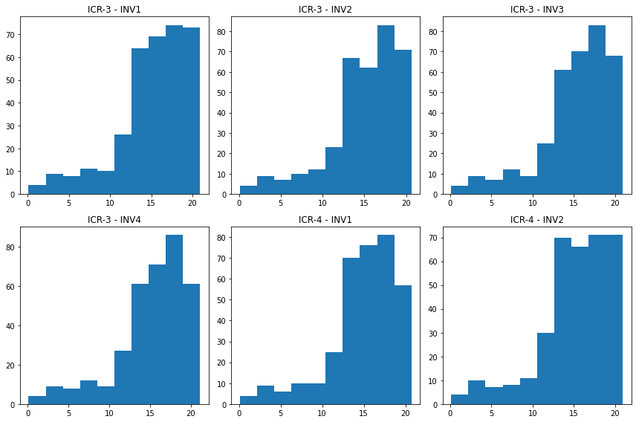
Exploratory Data Analysis [EDA]

Slide 22
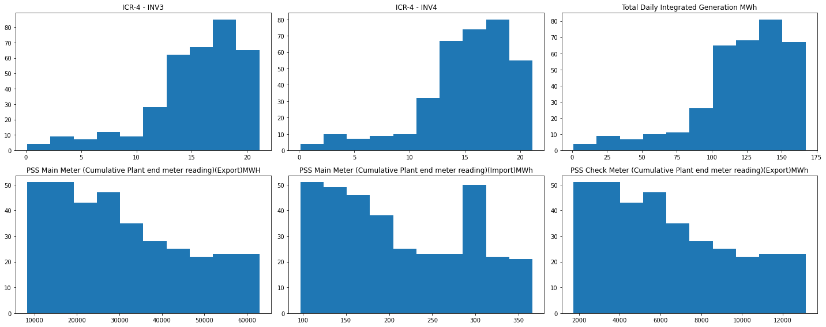
Exploratory Data Analysis [EDA]

Slide 23
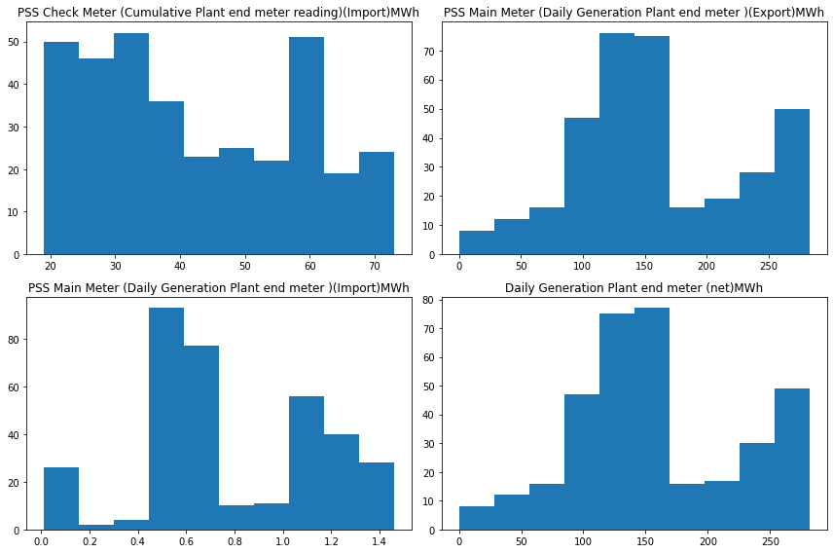
Exploratory Data Analysis [EDA]

Slide 24
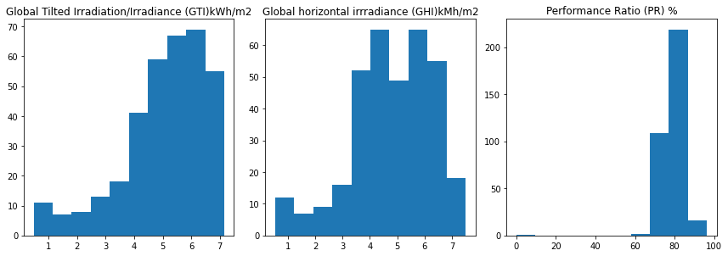
Exploratory Data Analysis [EDA]

Slide 25
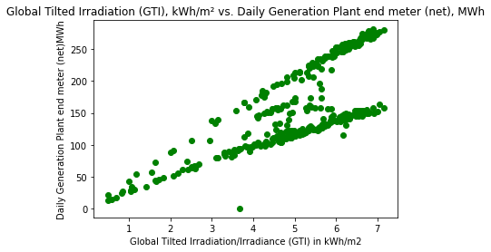
Exploratory Data Analysis [EDA]
The correlation coefficient is approximately 0.75. This indicates a strong positive correlation between GTI (kWh/m²) and the Daily Generation Plant's net meter readings (MWh).
As the GTI increases, the daily generation tends to increase as well.
Overall, the data indicates that GTI is a significant factor in determining the plant's daily energy generation,
and efforts to maximize GTI capture could directly enhance energy output.

Slide 26
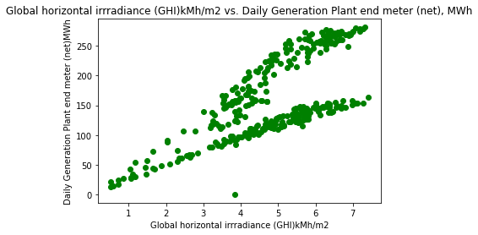
Exploratory Data Analysis [EDA]
The scatter plot shows a positive correlation between global horizontal irradiance (GHI) and daily generation at the power plant.
As the GHI increases, the daily generation also tends to increase.
This makes sense because higher solar irradiance means more energy is available to be converted into electricity by the solar power plant.
The correlation coefficient of around 0.71 indicates a fairly strong positive linear relationship between the two variables. However,
there is still some scatter in the data points, suggesting that other factors besides just GHI also influence the daily generation output.

Slide 27
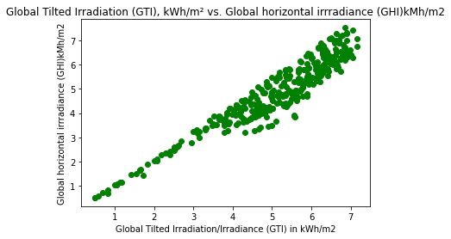
Exploratory Data Analysis [EDA]
The scatter plot shows a strong positive correlation between Global Tilted Irradiation (GTI) in kWh/m2 and
Global Horizontal Irradiance (GHI) in kMh/m2. The data points closely follow a linear trend, indicating that as GHI increases,
GTI also tends to increase proportionally. The calculated correlation coefficient of approximately 0.95 confirms this strong linear
relationship between the two variables.

Slide 28
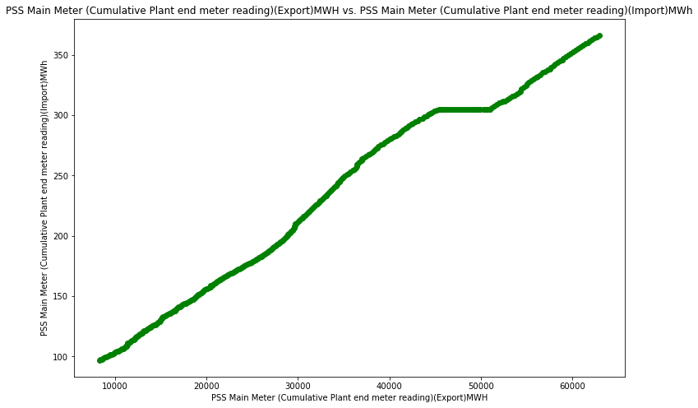
Exploratory Data Analysis [EDA]
The scatter plot shows an extremely strong positive correlation (correlation coefficient of 0.993) between the cumulative energy exported
from the power plant and the cumulative energy imported into the plant.
This near perfect linear relationship suggests that the amount of energy imported is directly proportional to the amount exported over time,
likely due to the need to import some energy from the grid to support plant operations and energy losses, even as the plant is exporting energy
generated from solar. The tight clustering of data points along the line indicates this relationship holds consistently across the observed period.

Slide 29
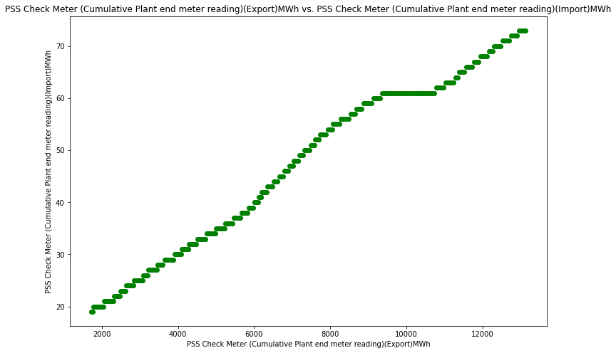
Exploratory Data Analysis [EDA]
The scatter plot shows an extremely strong positive correlation (correlation coefficient of around 0.993) between the cumulative energy
exported from the plant according to the PSS Check Meter and the cumulative energy imported into the plant according to the same meter.
The data points align almost perfectly along a straight line, indicating that the amount of energy imported is directly proportional to
the amount exported over time. This near 1:1 linear relationship suggests that the Check Meter readings for import and export are consistent
and reliable measures of the actual energy flows in and out of the plant. The tight clustering of points confirms this relationship holds
robustly across the observed period.

Slide 30
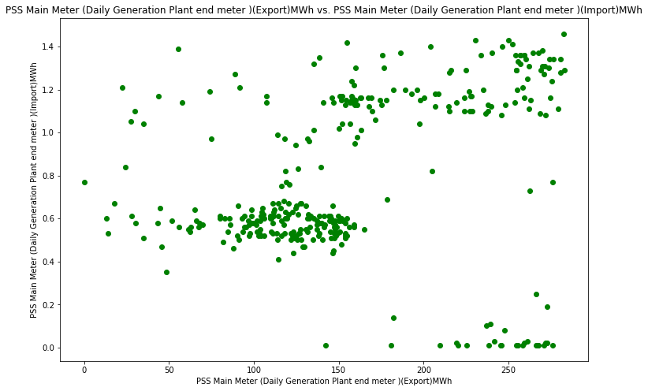
Exploratory Data Analysis [EDA]
The scatter plot shows a weak positive correlation (correlation coefficient of around 0.266) between the daily energy exported from the plant
and the daily energy imported into the plant, as measured by the PSS Main Meter. While there is an overall positive trend, the data points are
scattered and do not align closely to a straight line. This suggests that the daily import and export values do not have a consistent linear
relationship like the cumulative values did.

Slide 31
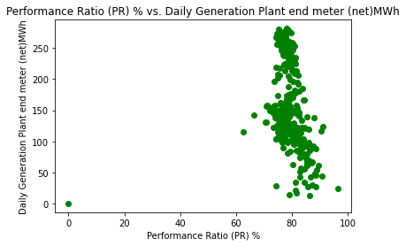
Exploratory Data Analysis [EDA]
the scatter plot shows a weak negative correlation (around -0.18) between the Performance Ratio percentage and
the Daily Generation Plant end meter net output. While there is an overall downward trend, the data points are quite scattered,
suggesting other factors beyond just the Performance Ratio significantly influence the daily net generation.
The relationship is modest and inconsistent across all data points.

Slide 32
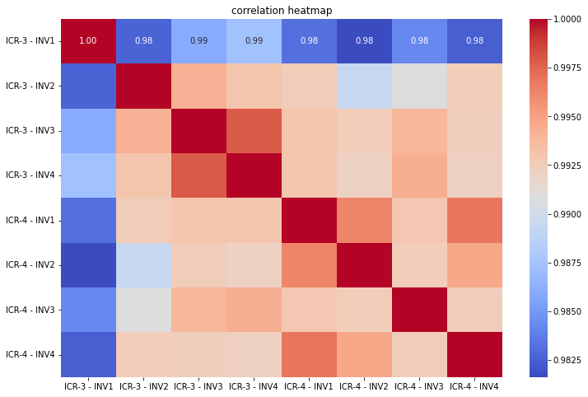
Exploratory Data Analysis [EDA]
There is very strong positive correlation (around 0.99) between the variables ICR-3 - INV1, ICR-3 - INV2, ICR-3 - INV3, and ICR-3 - INV4, as indicated by the dark red squares along the diagonal.
Similarly, the variables ICR-4 - INV1, ICR-4 - INV2, ICR-4 - INV3, and ICR-4 - INV4 also exhibit very strong positive correlation among themselves.
However, there is a relatively lower but still strong positive correlation (around 0.98) between the ICR-3 and ICR-4 groups of variables.
No significant negative correlations are observed among the variables considered.

Slide 33
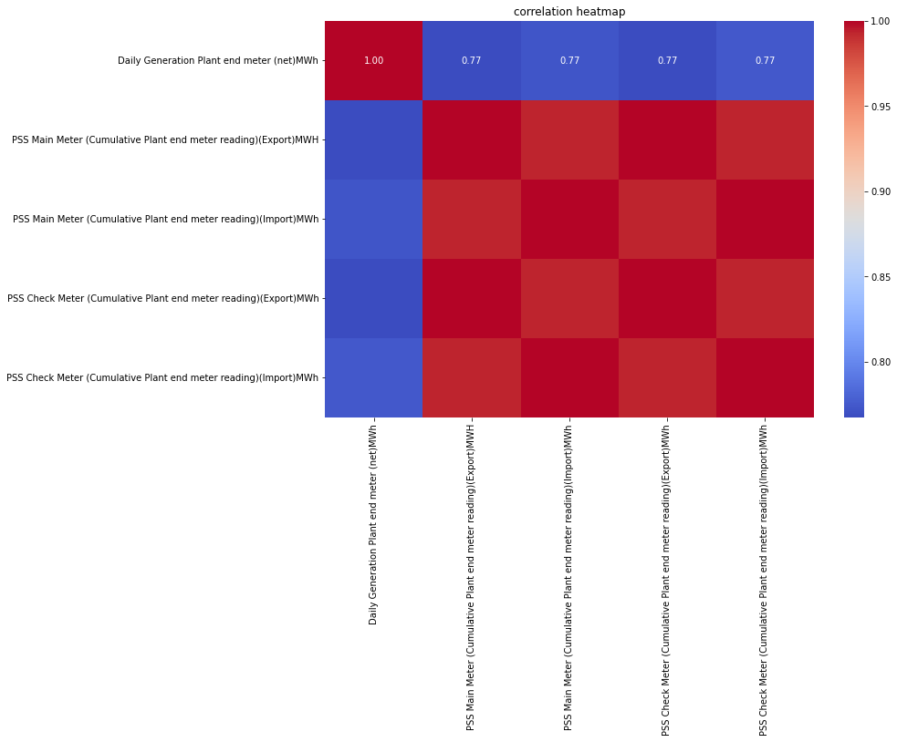
Exploratory Data Analysis [EDA]
The Daily Generation Plant end meter (net)MWh has a moderate positive correlation of 0.77 with all the other variables, indicating that higher daily generation is associated with higher export and import readings across the main and check meters.
The PSS Main Meter readings for Export and Import have a very strong positive correlation of 0.95, suggesting that the export and import values recorded by the main meter are closely related.
Similarly, the PSS Check Meter readings for Export and Import also exhibit a strong positive correlation of 0.80, indicating consistency between the export and import values recorded by the check meter.
The Main Meter and Check Meter readings for both Export and Import show moderate positive correlations (around 0.77), implying a reasonable level of agreement between the main and check meter readings.

Slide 34
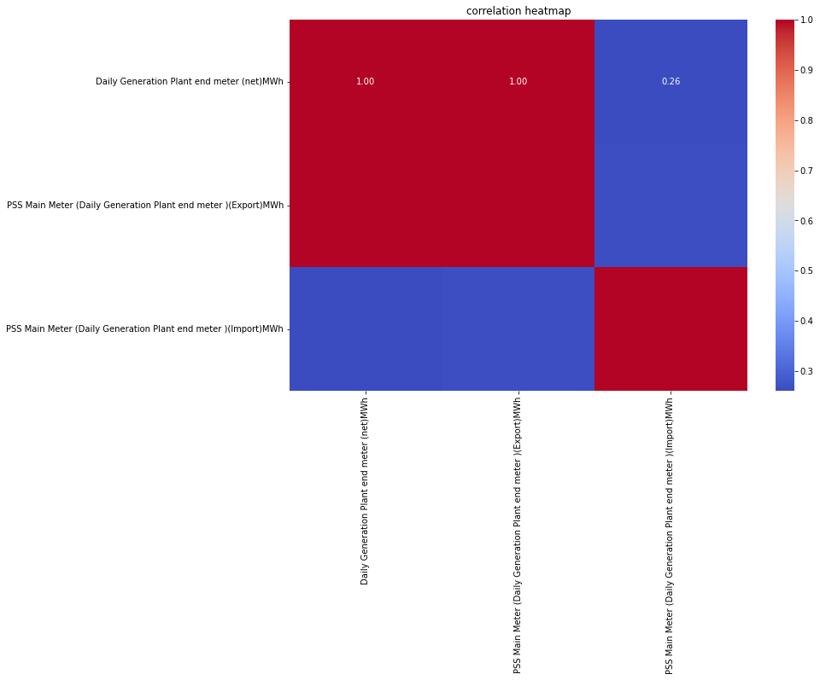
Exploratory Data Analysis [EDA]
There is a perfect positive correlation (1.0) between the Daily Generation Plant end meter (net)MWh and the PSS Main Meter (Daily Generation Plant end meter)(Export)MWh. This suggests that the net daily generation is entirely accounted for by the export readings on the main meter.
There is a very low positive correlation (0.26) between the Daily Generation Plant end meter (net)MWh and the PSS Main Meter (Daily Generation Plant end meter)(Import)MWh. This indicates that the import readings on the main meter are largely independent of the net daily generation.
There is a moderate negative correlation (-0.54) between the PSS Main Meter (Daily Generation Plant end meter)(Export)MWh and the PSS Main Meter (Daily Generation Plant end meter)(Import)MWh. This suggests that as exports increase, imports tend to decrease, or vice versa, which is an expected relationship in a power generation system.

Slide 35
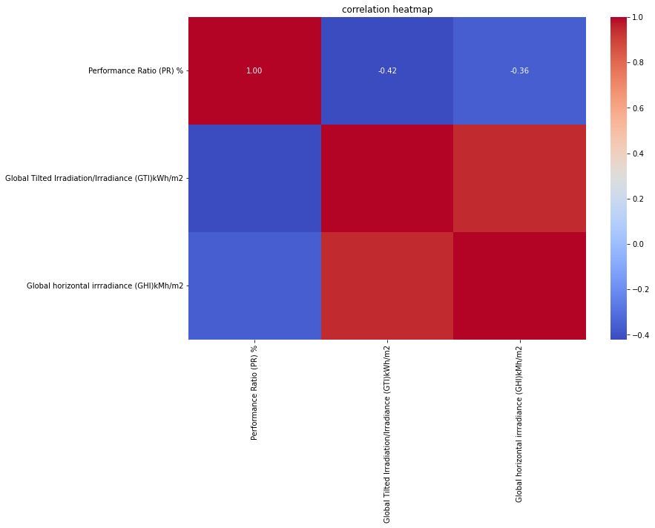
Exploratory Data Analysis [EDA]
There is a moderate positive correlation (0.42) between the Performance Ratio (PR) and Global Tilted Irradiation/Irradiance (GTI). This suggests that higher solar irradiation on the tilted surface is associated with a higher performance ratio of the solar plant.
There is a moderate negative correlation (-0.36) between the Performance Ratio (PR) and Global Horizontal Irradiance (GHI). This indicates that as the horizontal irradiance increases, the performance ratio tends to decrease slightly.
There is a strong positive correlation (0.95) between Global Tilted Irradiation/Irradiance (GTI) and Global Horizontal Irradiance (GHI). This is an expected relationship, as higher horizontal irradiance generally leads to higher irradiation on the tilted surface.

Slide 36

Data Preprocessing
Dropping Column :
In the dataset, the 'Grid Downtime HH' column contains only 2 non-null values, thus providing limited information for analysis.
Similarly, the 'Plant Downtime HH' column, having the same value for all entries, acks variability and useful information for analysis.
so we are dropping that column

Slide 37
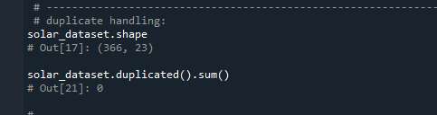
Data Preprocessing
Duplication Handling:
In the Solar Dataset, there is no duplicated records.

Slide 38
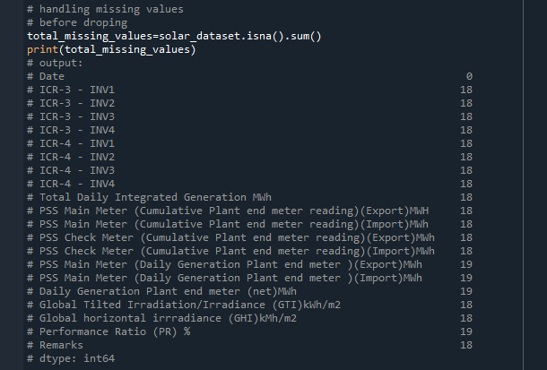
Data Preprocessing
Missing Value:

Slide 39
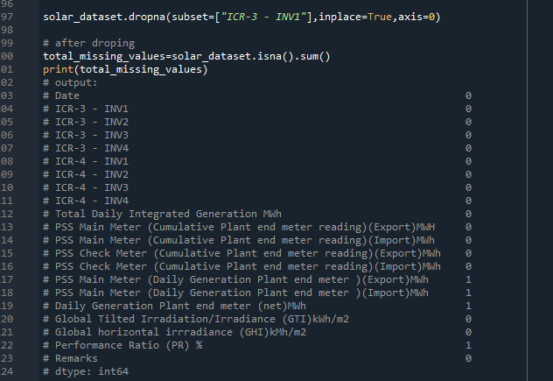
Data Preprocessing
Missing Value:
In the dataset, we observed that the bottom 18 rows contain only date values, while all other 19 columns do not contain any values, so we just dropped those rows.

Slide 40
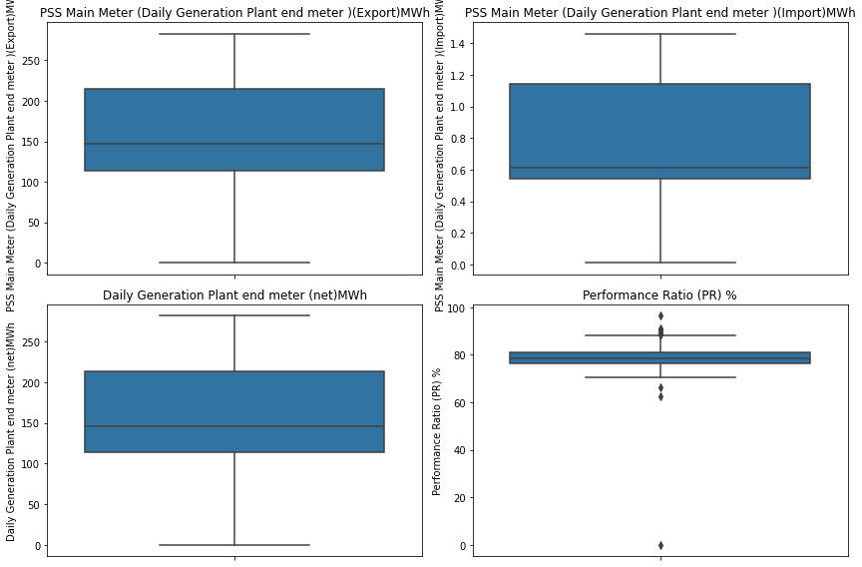
Data Preprocessing
there are still missing values in
PSS Main Meter (Daily Generation Plant end meter )(Export)MWh
PSS Main Meter (Daily Generation Plant end meter )(Import)MWh
Daily Generation Plant end meter (net)MWh
Performance Ratio (PR) % Here we checking for Outliers

Slide 41
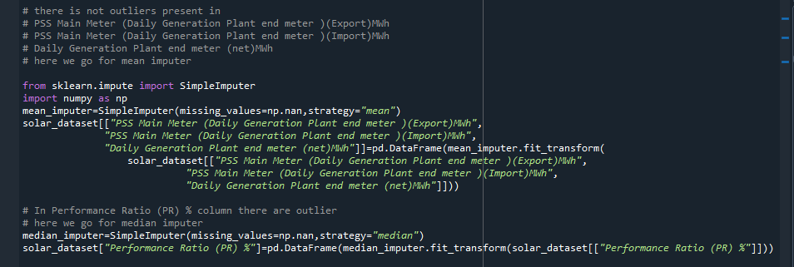
Data Preprocessing
there is no outliers present in
PSS Main Meter (Daily Generation Plant end meter )(Export)MWh
PSS Main Meter (Daily Generation Plant end meter )(Import)MWh
Daily Generation Plant end meter (net)MWh
here we go for mean imputer
In Performance Ratio (PR) % column there are outlier
here we go for median imputer

Slide 42
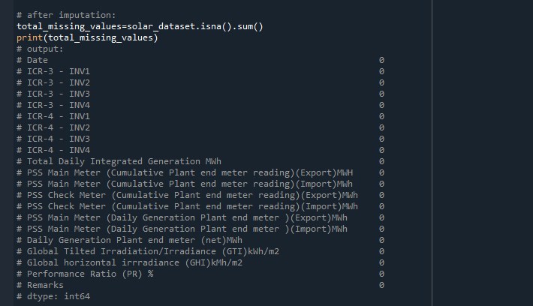
Data Preprocessing
After Imputation

Slide 43
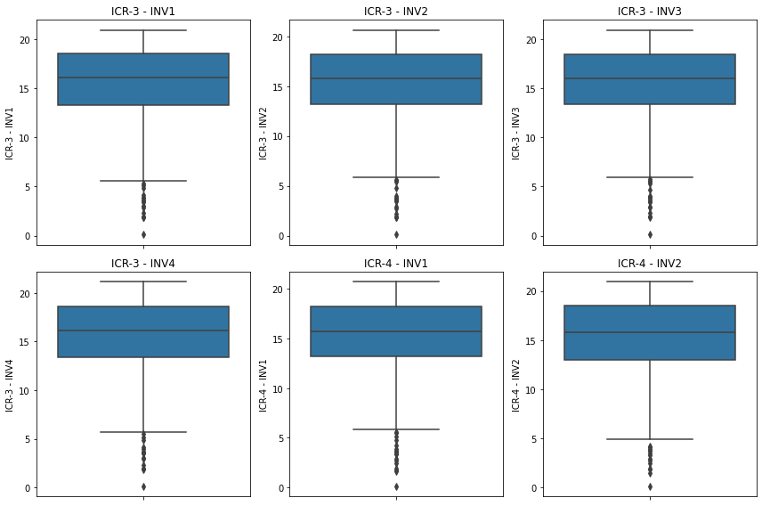
Data Preprocessing
Outliers :

Slide 44
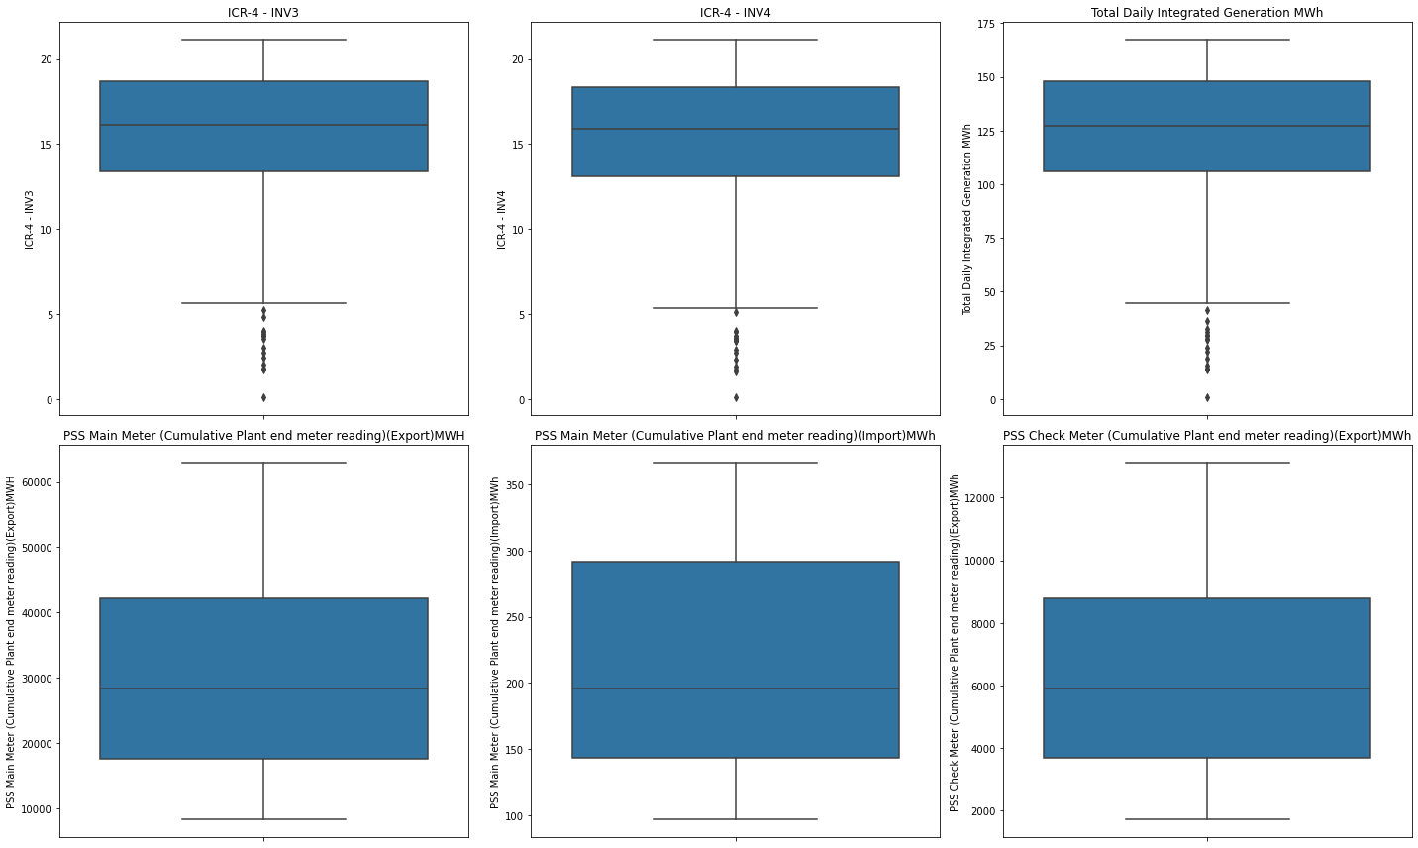
Data Preprocessing

Slide 45
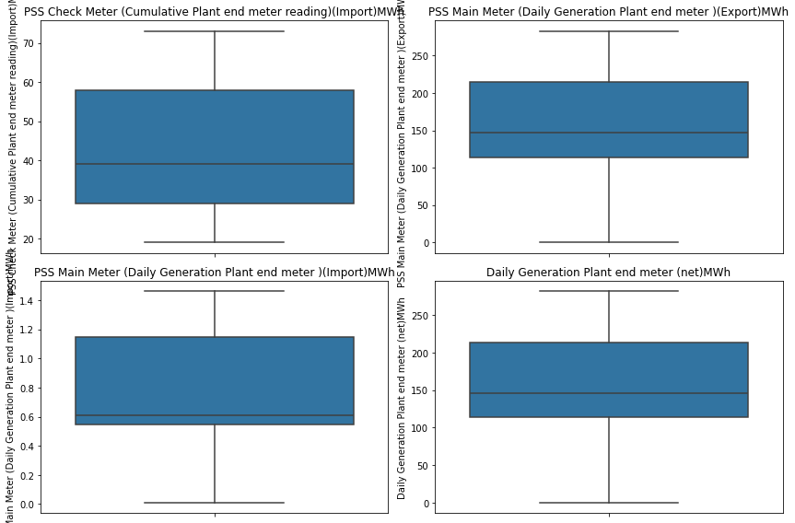
Data Preprocessing

Slide 46
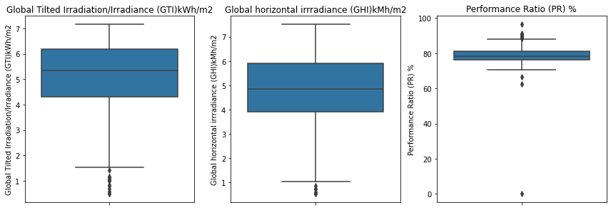
Data Preprocessing

Slide 47
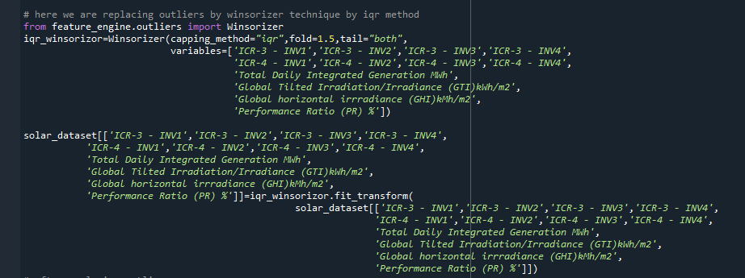
Data Preprocessing
columns which contain outliers are : 'ICR-3 - INV1', 'ICR-3 - INV2', 'ICR-3 - INV3', 'ICR-3 - INV4','ICR-4 - INV1', 'ICR-4 - INV2', 'ICR-4 - INV3',
'ICR-4 - INV4','Total Daily Integrated Generation MWh''Global Tilted Irradiation/Irradiance (GTI)kWh/m2','Global horizontal irradiance (GHI)kMh/m2', 'Performance Ratio (PR) %
By using the Winsorizer IQR method, we are going to replace outliers in all the above columns.

Slide 48
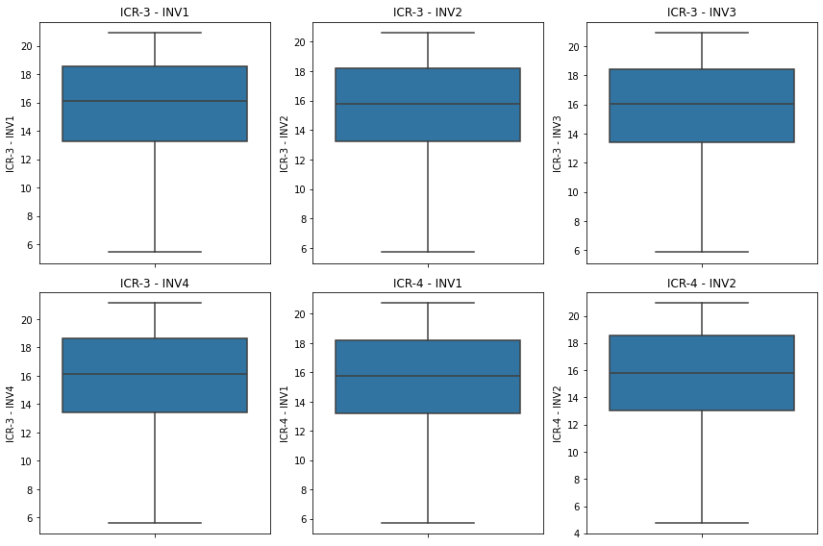
Data Preprocessing
After replacing Outliers:

Slide 49
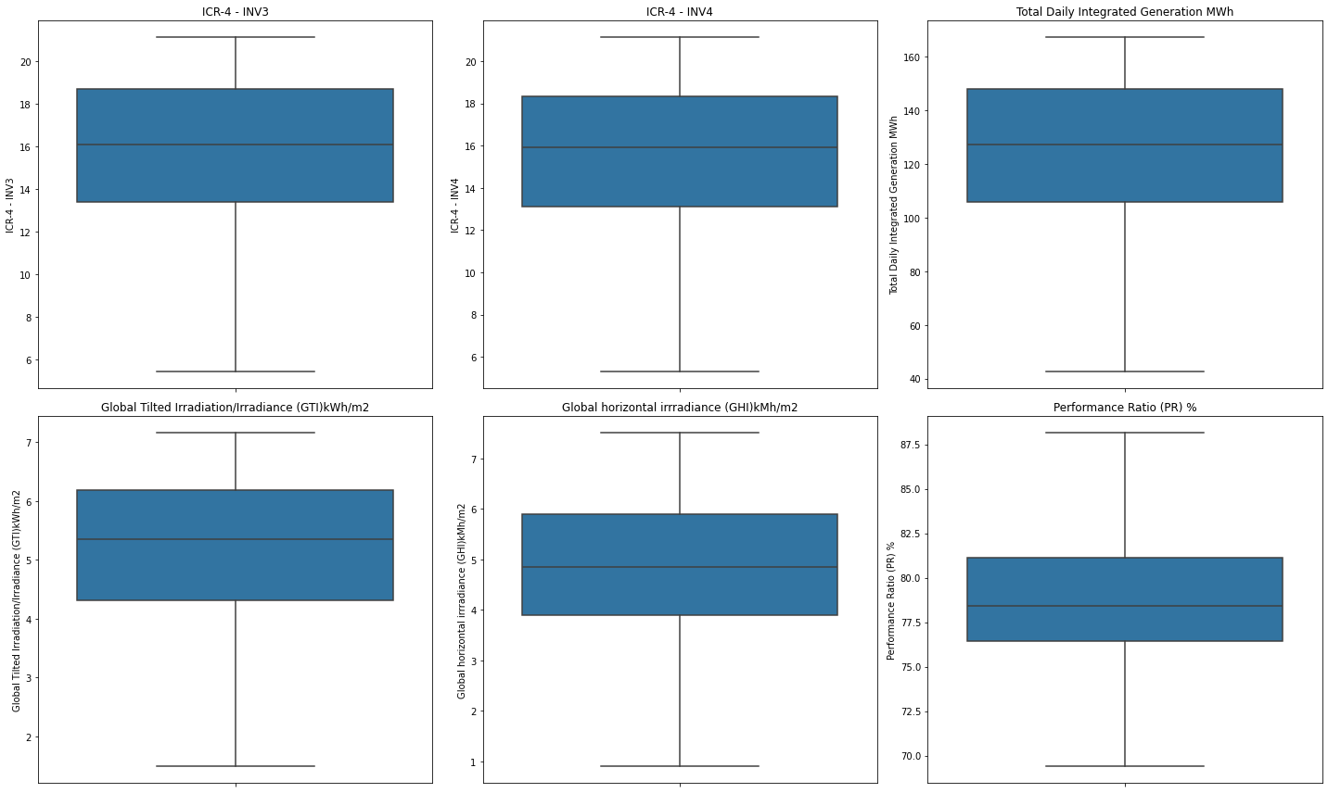
Data Preprocessing

Slide 50
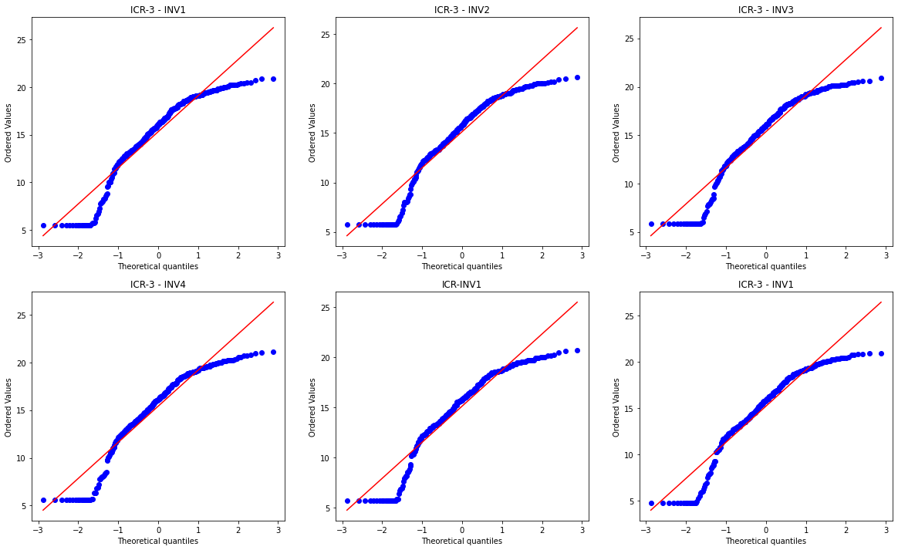
Data Preprocessing
Normalization :

Slide 51
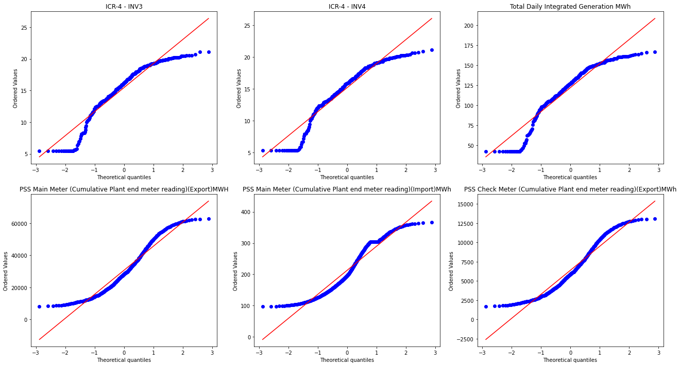
Data Preprocessing

Slide 52
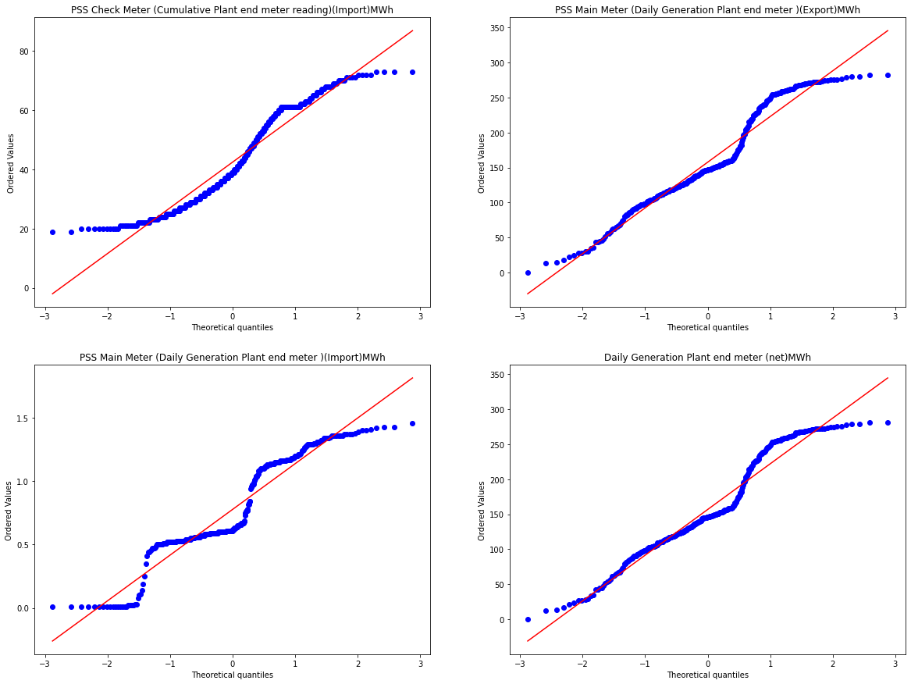
Data Preprocessing

Slide 53
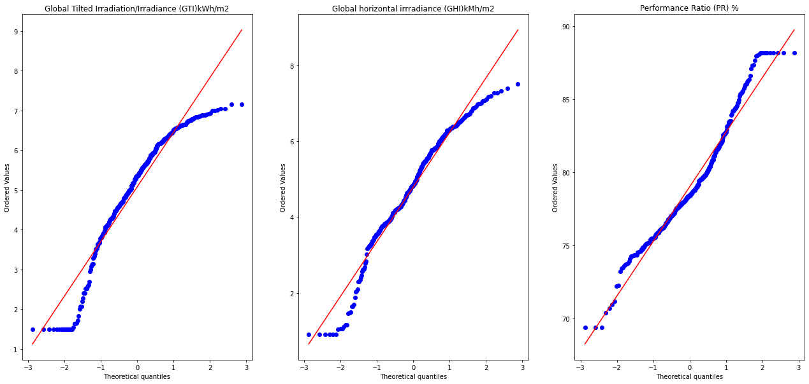
Data Preprocessing

Slide 54
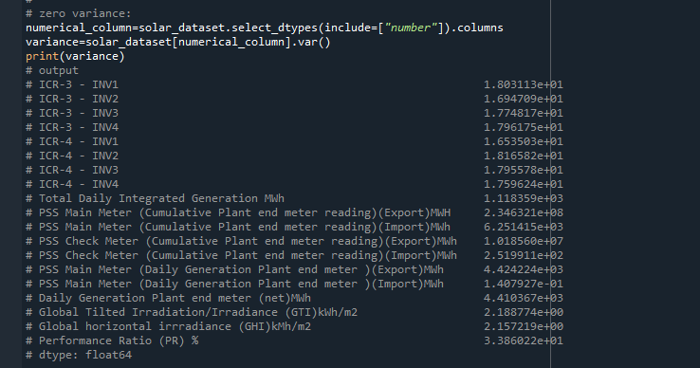
Data Preprocessing
Zero Variance :
In the solar dataset, there is no zero-variance column.

Slide 55
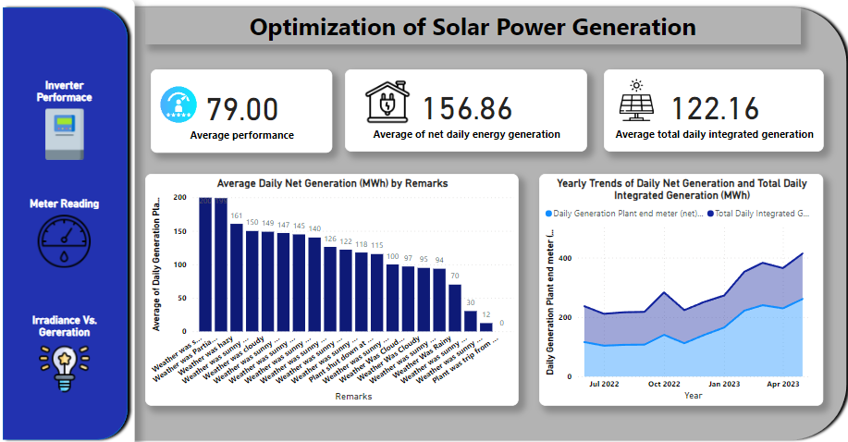
Data Visualization
Notes:
Add graphical

Slide 56
Data Visualization
Above dashboard provides insights into the optimization of solar power generation. The key observations are:
Average Performance: The inverter performance is rated at 79.00 on average.
Net Daily Energy Generation: The average net daily energy generation from the solar power system is 156.86 kWh.
Total Daily Integrated Generation: The average total daily integrated generation is 122.16 kWh.
Daily Net Generation by Remarks: The bar chart shows the average daily net generation (kWh) for different remarks or conditions. The highest generation is observe when Weather was sunny, while factors like clouds, high winds, and snow cover lead to lower generation.
Yearly Trends: The line chart displays the yearly trends of daily net generation and total daily integrated generation. It shows an increasing trend, indicating improved solar power generation over time.
Monitoring: The image suggests that the solar power system is equipped with monitoring capabilities like inverter performance tracking, meter reading, and irradiance vs. generation measurement, which aid in optimizing the system's performance.
Notes:
Add graphical

Slide 57
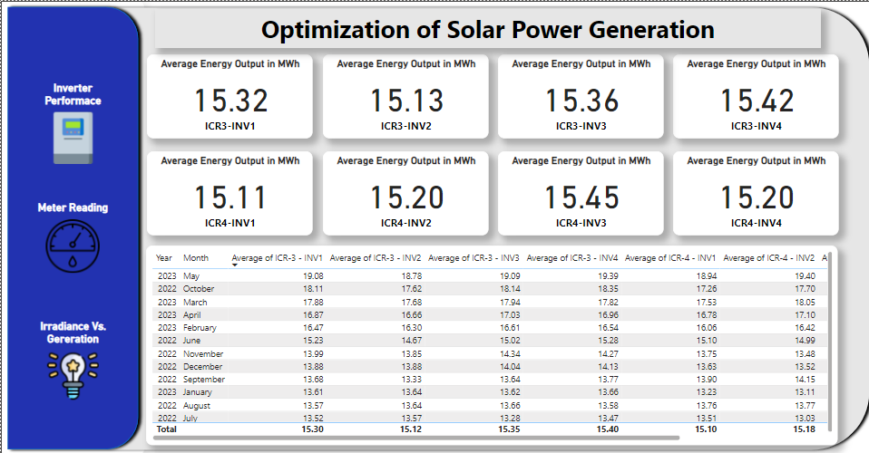
Data Visualization
Notes:
Add graphical

Slide 58
Data Visualization
This image provides detailed insights into the optimization of solar power generation by presenting average energy outputs from multiple inverters over different months and years. Here are the key observations:
Inverter Performance: The average energy outputs (in MWh) from four inverters (ICR3-INV1, ICR3-INV2, ICR3-INV3, and ICR3-INV4, ICR4-INV1, ICR4-INV2, ICR4-INV3, and ICR4-INV4) are shown for comparison.
Monthly and Yearly Trends: A table displays the average energy outputs for each inverter on a monthly and yearly basis from June 2022 to May 2023.
Inverter Performance:
ICR4-INV3 has the highest average energy output (15.45 MWh), while ICR4-INV1 has the lowest (15.11 MWh).
All inverters have similar performance, indicating a well-maintained and balanced system.
Monthly Variations:
The variations in monthly performance are consistent across all inverters, with peaks in the spring and summer months and troughs in the winter months.
Notes:
Add graphical

Slide 59
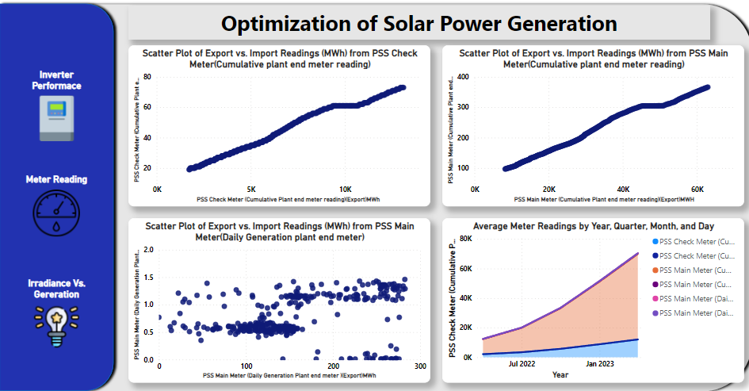
Data Visualization
Notes:
Add graphical

Slide 60
Data Visualization
The Above dashboard focuses on the export vs. import readings (MWh) from different meters and provides insights on average meter readings over time. Here's an analysis of the different sections:
Scatter Plot of Export vs. Import Readings (MWh) from PSS Check Meter (Cumulative plant end meter reading):
This plot shows a strong positive correlation between export and import readings (MWh) on the PSS Check Meter.
As the export readings increase, the import readings also increase, indicating a consistent balance between the export and import measurements.
Scatter Plot of Export vs. Import Readings (MWh) from PSS Main Meter (Cumulative plant end meter reading):
Similar to the first plot, there is a strong positive correlation between export and import readings (MWh) on the PSS Main Meter.
The trend is linear, suggesting reliable and consistent meter readings for both export and import.
Scatter Plot of Export vs. Import Readings (MWh) from PSS Main Meter (Daily Generation plant end meter):
This scatter plot shows the daily export vs. import readings (MWh) from the PSS Main Meter.
Unlike the cumulative readings, the daily readings show more variability and dispersion.
The correlation is less pronounced, which could indicate daily fluctuations in generation and consumption that are averaged out in cumulative readings.
Average Meter Readings by Year, Quarter, Month, and Day:
This line chart shows the average meter readings for both the PSS Check Meter and PSS Main Meter over time.
There is a clear upward trend in average readings from July 2022 to January 2023, indicating increased activity or production over this period.
The readings from the PSS Check Meter and PSS Main Meter follow similar trends, reinforcing the reliability of the data.
Notes:
Add graphical

Slide 61
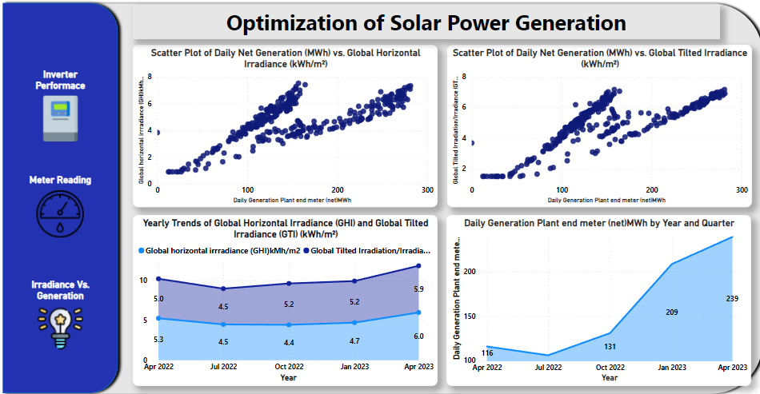
Data Visualization
Notes:
Add graphical

Slide 62
Data Visualization
The dashboard provided visualizes the optimization of solar power generation through various charts and metrics. Here are the insights from the different sections of the dashboard:
Scatter Plot of Daily Net Generation (MWh) vs. Global Horizontal Irradiance (kWh/m²):
The plot shows a positive correlation between daily net generation (MWh) and global horizontal irradiance (kWh/m²).
As the irradiance increases, the daily net generation also increases, indicating that higher irradiance leads to higher power generation.
Scatter Plot of Daily Net Generation (MWh) vs. Global Tilted Irradiance (kWh/m²):
This plot also shows a positive correlation between daily net generation (MWh) and global tilted irradiance (kWh/m²).
The generation increases with an increase in tilted irradiance, suggesting that optimizing the tilt angle of the solar panels could enhance power generation.
Yearly Trends of Global Horizontal Irradiance (GHI) and Global Tilted Irradiance (GTI) (kWh/m²):
The line graph illustrates the yearly trends for GHI and GTI from April 2022 to April 2023.
GHI fluctuated slightly but generally stayed between 4.5 and 5.9 kWh/m².
GTI remained stable around 5.0 kWh/m² with minor fluctuations, slightly higher during October 2022 to April 2023.
Both irradiance measures increased towards the end of the period.
Daily Generation Plant End Meter (net) MWh by Year and Quarter:
This bar chart shows the daily generation by quarter from April 2022 to April 2023.
There is a noticeable increase in the daily net generation over the quarters.
Starting from a low of around 15 MWh in April 2022, there was a significant increase to 131 MWh in October 2022, 209 MWh in January 2023, and reaching 239 MWh by April 2023.
The upward trend indicates a consistent improvement in power generation, possibly due to better irradiance conditions, optimizations, or improvements in the solar plant's performance.
Notes:
Add graphical

Slide 63
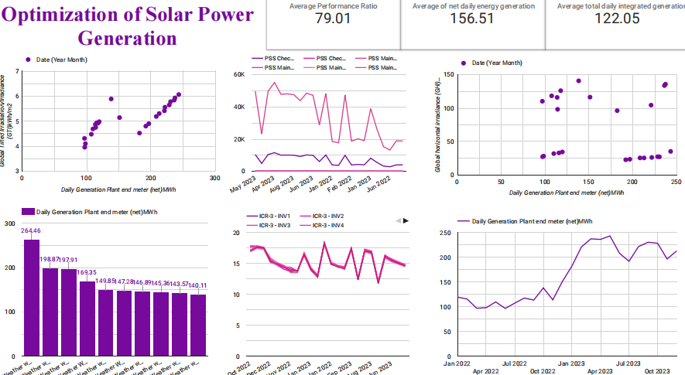
Data Visualization
Google looker studio:
Notes:
Add graphical

Slide 64
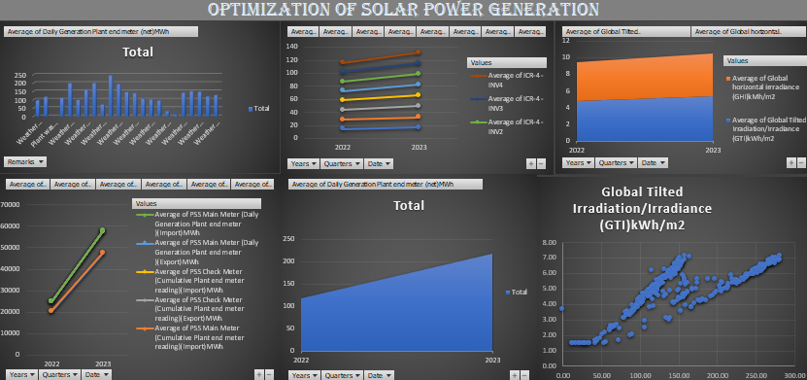
Data Visualization
Excel:
Notes:
Add graphical

Slide 65
Challenges
Weather Dependence:
Variability: The solar power generation is highly dependent on weather conditions. As indicated, clouds, high winds, and snow cover significantly reduce energy output. This variability makes it challenging to predict and rely on solar power as a consistent energy source.
Impact on Planning: Due to this dependency, energy planners need to account for backup power sources or storage solutions to ensure a stable energy supply.
Inverter Performance:
Performance Variability: Although the average inverter performance is good, there can still be variability between individual inverters. Identifying and addressing underperforming inverters is crucial for maintaining overall system efficiency.
Maintenance Needs: Regular maintenance and performance tracking are required to ensure inverters operate optimally. This can be resource-intensive.
Data Accuracy and Monitoring:
Measurement Errors: Ensuring the accuracy of meter readings and irradiance measurements is critical. Any errors can lead to incorrect assessments of system performance and inefficiencies in energy generation.
Monitoring Costs: Implementing and maintaining advanced monitoring systems can be costly and require technical expertise.
Seasonal Variations:
Production Fluctuations: The data shows seasonal trends in energy generation. During winter months, production drops, which can affect energy availability and necessitate additional storage or alternative energy sources during these periods.

Slide 66
Future Scopes
Improved Weather Forecasting and Adaptation:
Advanced Models: Developing better predictive models for weather patterns can help in planning and optimizing solar power generation.
Adaptive Systems: Implementing systems that can adjust to weather conditions, such as solar trackers and automated tilt adjustments, can help maximize energy capture.
Enhanced Storage Solutions:
Battery Storage: Integrating advanced battery storage systems can mitigate the challenges posed by weather variability and ensure a steady supply of power.
Grid Integration: Better integration with the grid and other renewable sources can provide more stability and reliability in energy supply.
Technological Innovations:
Inverter Technology: Advancements in inverter technology can lead to higher efficiencies and better performance tracking capabilities.
Panel Efficiency: Research and development in solar panel materials and designs can result in higher energy conversion efficiencies and better performance under sub-optimal conditions.

Slide 67
Future Scopes
Predictive Maintenance:
AI and Machine Learning: Utilizing AI and machine learning algorithms to predict and prevent inverter failures or inefficiencies can enhance system reliability and reduce downtime.
Remote Monitoring: Expanding remote monitoring capabilities can provide real-time insights and quicker responses to any issues.
Policy and Incentives:
Government Support: Policies that support the deployment of solar power and provide incentives for innovations in this field can accelerate the adoption and optimization of solar energy systems.
Subsidies for Storage: Providing subsidies for energy storage solutions can help balance the intermittent nature of solar power and promote more widespread use.
Data Analytics:
Advanced Analytics: Leveraging big data and advanced analytics to gain deeper insights into performance patterns, optimize operations, and forecast future performance.
Integration with Other Data Sources: Combining solar generation data with other environmental and operational data sources can lead to more holistic optimization strategies.

Slide 68


